Slide 1





Employee Data Analysis using Excel
STUDENT NAME: V Manasa
REGISTER NO: 312216132
NM ID: asunm1621312216132
DEPARTMENT: B.COM A&F COLLEGE:
1

Slide 2

PROJECT TITLE
Employee Performance Analysis using Excel
2

Slide 3



AGENDA
1.Problem Statement
2.Project Overview 3.End Users 4.Our Solution and Proposition 5.Dataset Description 6.Modelling Approach 7.Results and Discussion 8.Conclusion
3/21/2024 AnnualReview
3

Slide 4


PROBLEM STATEMENT
➢
Identify strengths and weakness: Helps recognize employees strengths and areas needing improvement
Enhance productivity: encourages better performance
and productivity through targeted feedback
➢
➢
Set goals and expectations: Establishes clear
performances goals and expectations for employees Support professional development: aids in identifying
training and development needs for career growth
➢
4

Slide 5

PROJECT OVERVIEW
➢
Employee data analysis involves systematically examining and
interpreting data related to employees to make informed decisions about workforce management
Analyzing performance metrics to access individual and team
➢
contributions and productivity
Trends to forecast future workforce needs and inform hiring and staffing strategies
Presenting findings through reports and visualizations to aid in understanding and decision making processes
➢
➢
5

Slide 6
WHO ARE THE END USERS?
• • •
•
•
•
Human resources(HR) Managers and team leaders Executives and senior leadership Data analysts and HR analysts
Learning and development
team Compensation and benefits s pe c ia list s
6

Slide 7


OUR SOLUTION AND ITS VALUE PROPOSITION
➢
Conditional formatting : used to find out blank cell and highlight the cell
Filter: used to remove the unwanted cell in the excel
Formula: used to finalise the performance of the
employee in the organisation
Pivot: it gives us the summary of the employee data
analytics
Graph : we can easily understand by the visual
representation of the large data in a simply format
➢ ➢
➢
➢
7

Slide 8
Dataset Description
downloaded from
•
Employee dataset:
Kaggle
Totally they are 26 features we have taken 9 of them for our preparation
•
Features
• • • • • •
Employee ID Number Name of the employee Employee's job description Performance level Gender: Male/Female Employee rating : Numerical values

Slide 9


THE "WOW" IN OUR SOLUTION
Performance level was the new feature learnt
Performance level= ifs(Z8>5,"very high",Z8>=4,"high",Z8=3,"med","true","low"
3/21/2024 AnnualReview
9

Slide 10


MODELLING
• • • •
Data collection: Collected the data in edunet dashboard
Feature collection:
Identifying each feature type and working on it
sp eci fi ca ll y
Data cleaning:
Finding out the missing values
Filtering out those missing values
Performances level:
Pivot point making slice option
Su mma ry:
The final result can be witnessed through piovt
table chart and graphical representation
• • •
•
•
•
•
10

Slide 11
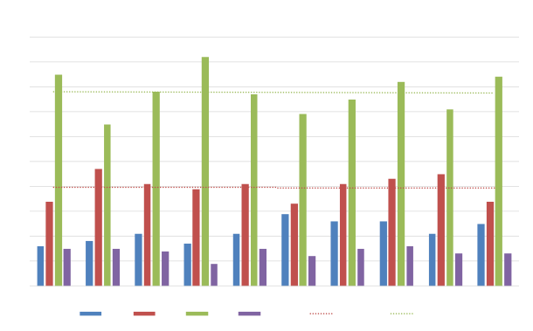
RESULTS
Employee Performance analysis
100
90
80
70
60
50
40
30
20
10
0
BPC
CCDR
EW
MSC
NEL
PL
PYZ
SVG
TNS
WBL
HIGH
LOW
MED
VERY HIGH
Expon. (LOW)
Linear (MED)
11

Slide 12
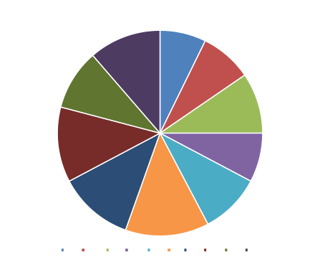
Pie chart for High performance level
HIGH
BPC
CCDR
EW
MSC
NEL
PL
PYZ
SVG
TNS
WBL

Slide 13
conclusion
Employee data analysis using Excel provides valuable insights into various aspects of workforce management. By effectively utilizing Excel's features such as pivot tables, charts and formulas organizations can identify trends, monitor performance and make data- driven decisions to enhance productivity and employee satisfaction. The ability to analyze data systematically helps in uncovering patterns, optimizing resource allocation and developing strategic initiatives. Overall, Excel serves as a powerful tool for transforming raw employee data into actionable insights, contributing
to more informed and strategic HR practices

